Slide 1
The Great Acceleration
By Will McWilliams

Slide 2
Intro
Is there a correlation between carbon emissions and climate change?
Which countries are the most responsible for the carbon emissions?
What industries are producing the most carbon emissions?

Slide 3

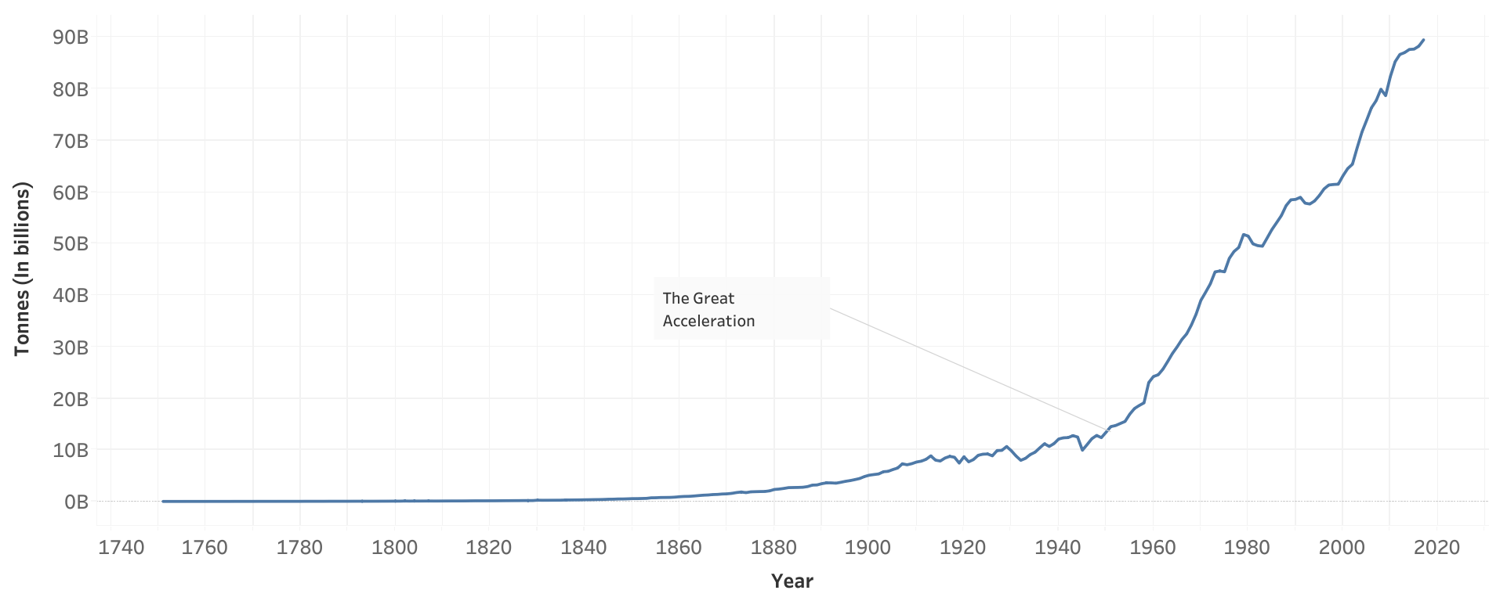
Total CO2 (1751-2017)

Slide 4
The Great Acceleration
Mid 20th century
Majority of countries on the planet
Exponentially increased its growth rate of progress
Increase of burning fossil fuels (coal, oil, natural gases, etc.), concrete Manufacturing, and Flaring

Slide 5
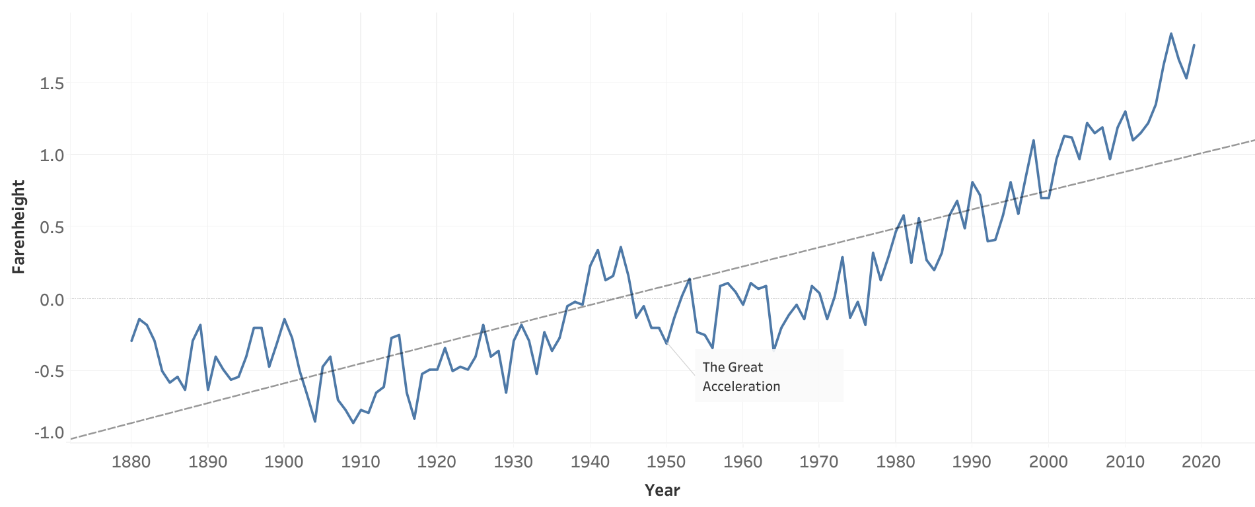
Global Averages (1880-2019)

Slide 6
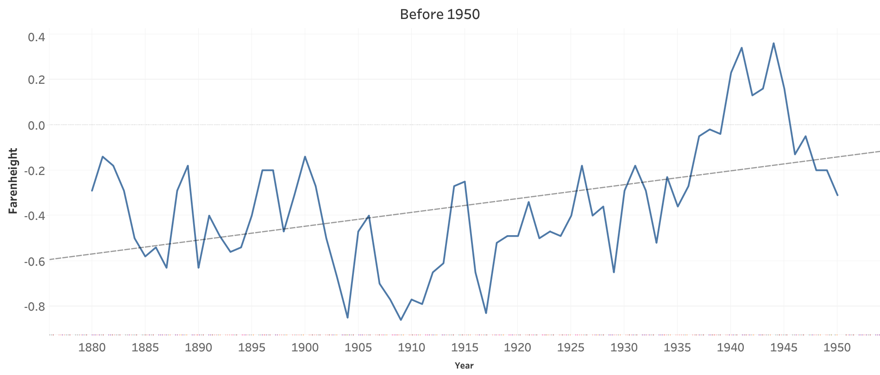
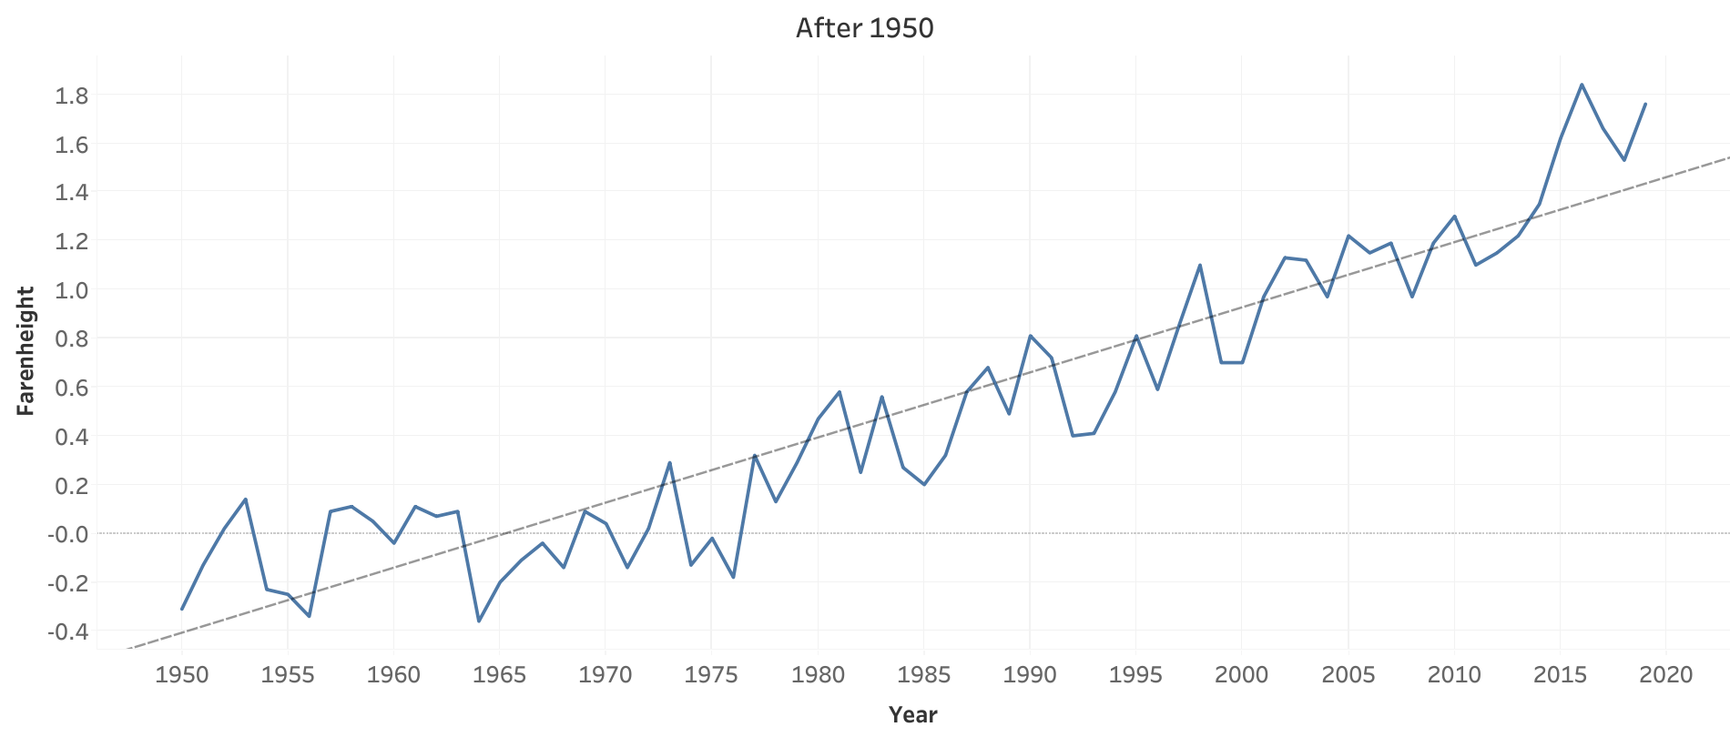
Before and After 1950

Slide 7
Break down of natural disasters
Earthquakes
Volcanoes
Landslides
Droughts
Extreme Weather (Hurricanes, Tornados, Cyclones)
Floods
Extreme temperature spikes
Wildfires
Lightning

Slide 8
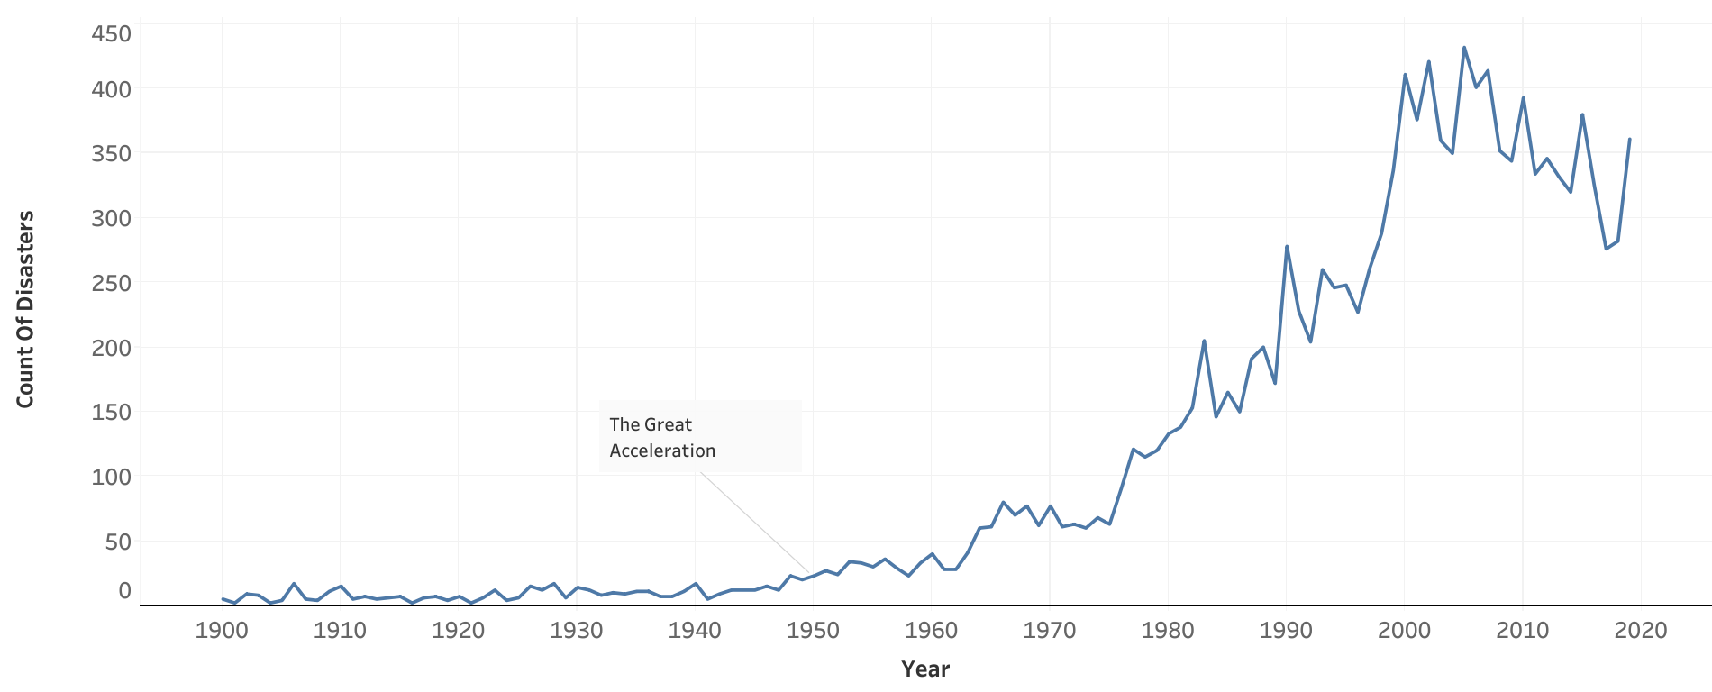
Natural Disasters

Slide 9
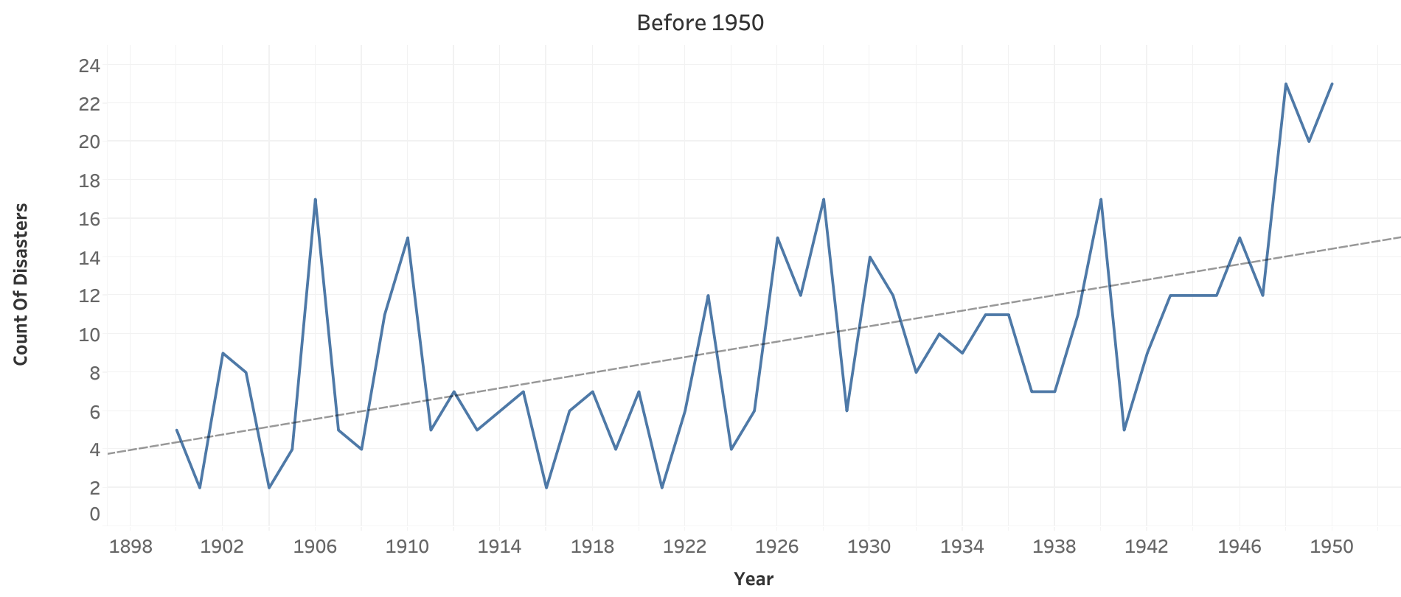
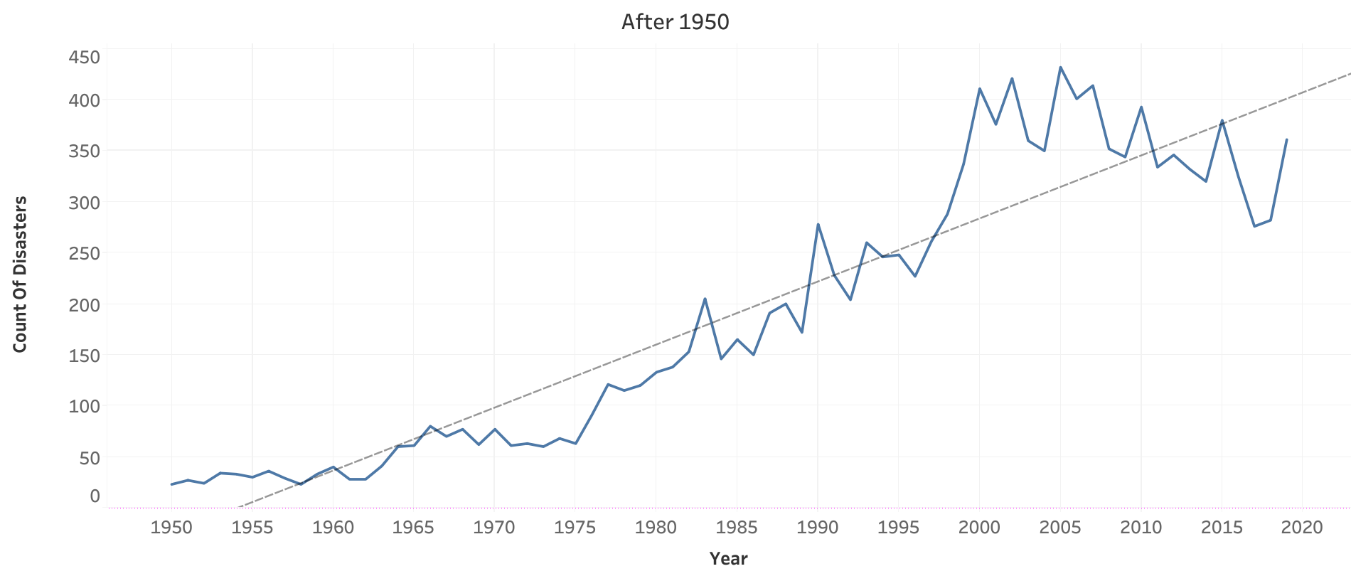
Before and After 1950

Slide 10
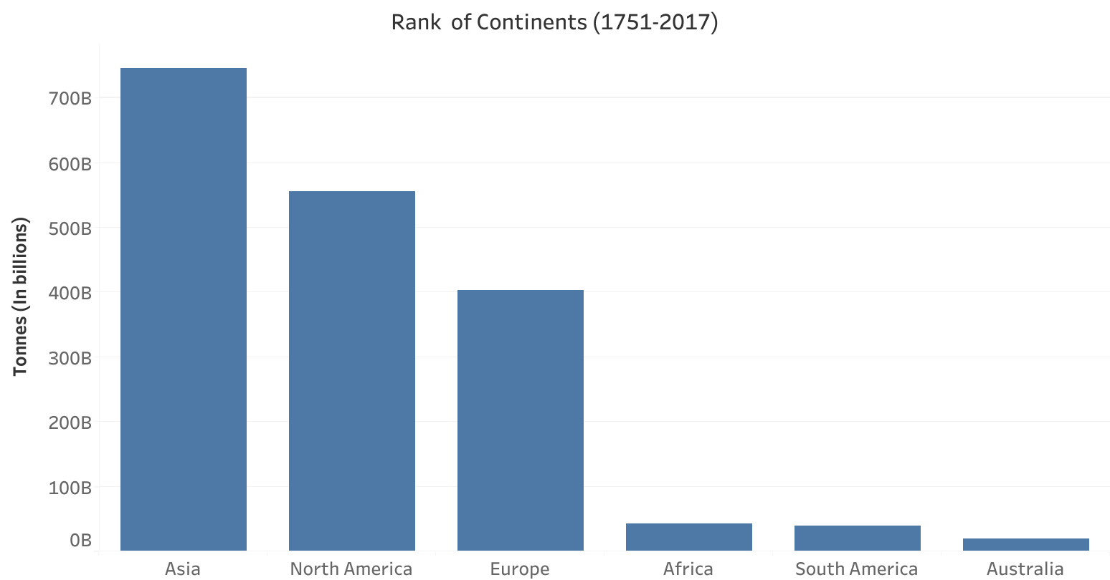
Rank of Continents

Slide 11
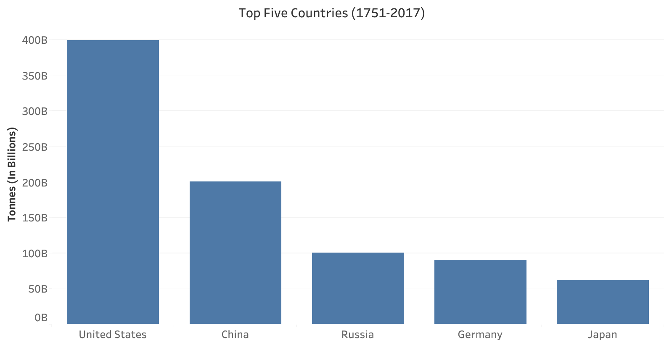
Top 5 Countries

Slide 12
Sources of Green House Gas
Coal (electricity and steel production)
Oil (transportation)
Natrual Gas (electricity and industry)
Cement (infrastructure)
Flaring (crude oil extraction)

Slide 13
Conclusion
When carbon emissions rapidly increased, earths climate began to change at a faster rate.
This rapid increase in carbon emissions is largely due to the demands created from an increasing global population. (The Great Acceleration)
Top five sources of carbon emissions:
Coal (electricity and steel production)
Oil (transportation)
Gas (electricity and industry)
Cement (infrastructure)
Flaring (crude oil extraction)

Slide 14
Conclusion cont.
The top five emitters are:
United States
China
Russia
Germany
Japan

Slide 15
Questions?

